Slide 1
Chapter4: Methodologies for building secure distributed software
Prof. E.B.Fernandez

Slide 2
What is a security methodology?
--Methodology: systematic way of doing something
--Security methodology: systematic way of introducing security into a
software system during the development life-cycle
--Advantages analogous to those of software engineering process vs. ad-hoc development
--Partial or comprehensive; covering early phases of the development life-
cycle especially important
--A security methodology SM = (SP, CF)
--SP is a security process, the activities and/or steps take to secure
a software system
--CF is a conceptual security framework consisting of conceptual
artifacts that include a set of security solutions and a set of
threats
--Can be specific (e.g. Web services) or generic

Slide 3
Importance of secure methodologies
Security methodologies are fundamental for safety-critical systems, where human lives, important or costly data or infrastructure are involved
They require more upfront work than agile methods and more planning but it is not possible to reach a high level of security with simpler approaches
Some of the steps could be simplified to apply them to cases where security requirements are not so strict

Slide 4
Security principles for application design
Security constraints must be defined at the highest layer, where their semantics are clear, and propagated to the lower levels, which enforce them.
All the layers of the architecture must be secure.
We can define patterns at all levels. This allows a designer to make sure that all levels are secured, and also makes easier propagating down the high-level constraints.
We must apply security at all development stages
A two-dimensional approach: time and space

Slide 5
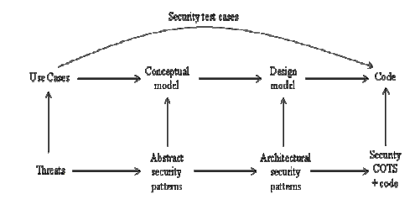
From use cases to secure systems

Slide 6

ASE: a security methodology for distributed systems [Uzu15]
Many methodologies exist with different paradigms [Uzu13]
Very important class is methodologies that use security patterns
ASE: a security methodology using patterns and related constructs designed specifically for general distributed systems
An extension of my early methodology [Fer13]

Slide 7

Major elements of CF: Decomposition Framework
A 3 level framework for decomposing distributed software architectures
High-level modeling abstractions – consistent concepts
Functionality decomposition layers – isolation
Technical realization abstractions – detail

Slide 8
Security along the life cycle

Slide 9

Major elements of CF: Security patterns and security solution frames
Security patterns are software patterns that encapsulate successful security designs
Can be simple or compound
Security solution frames encapsulate and organize security patterns into different levels of abstraction (vertically) and different facets of a root security policy (horizontrally)

Slide 10
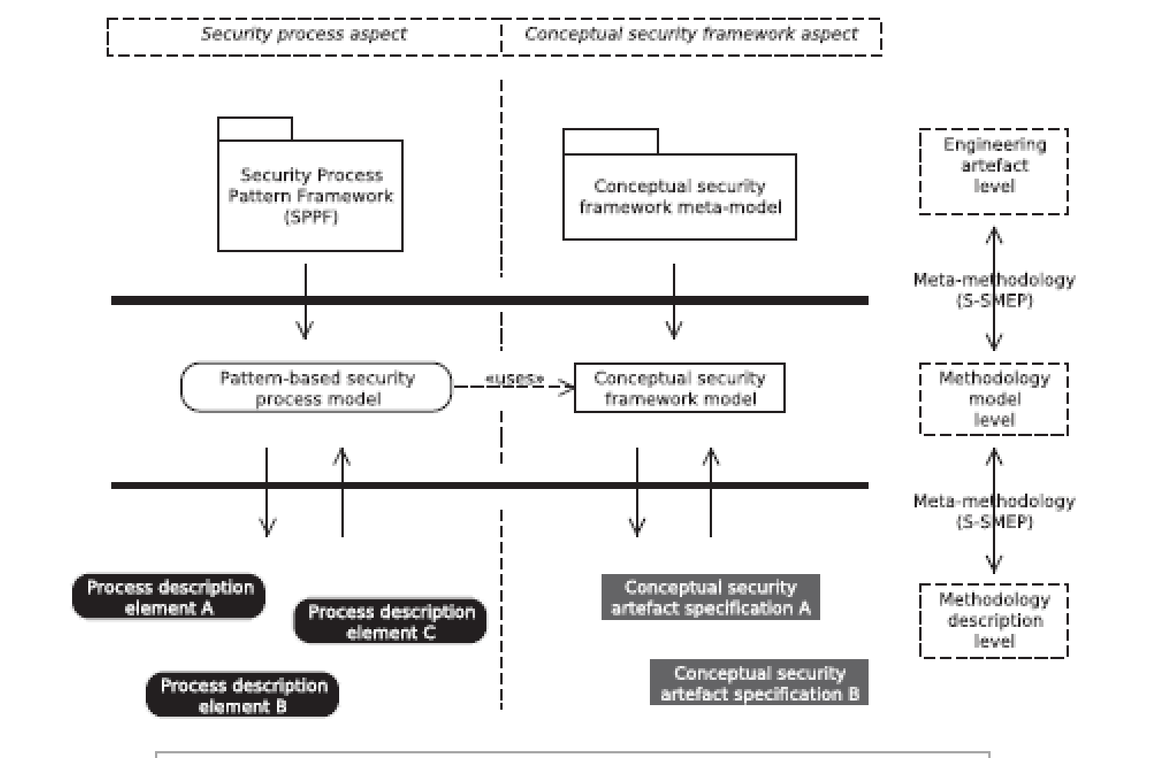
General approach

Slide 11
Engineering a security methodology
SPPF (Security Process Pattern Framework)—for engineering the process aspects of the methodology
A metamodel for fo engineering a conceptual security aspect
S-SMEP (Situational Security Methodolgy Engineering Process) –a unified methodology to guide designers in using patterns
Process patterns are classified as Phase (P), Stage (S), and Task (T) patterns

Slide 12
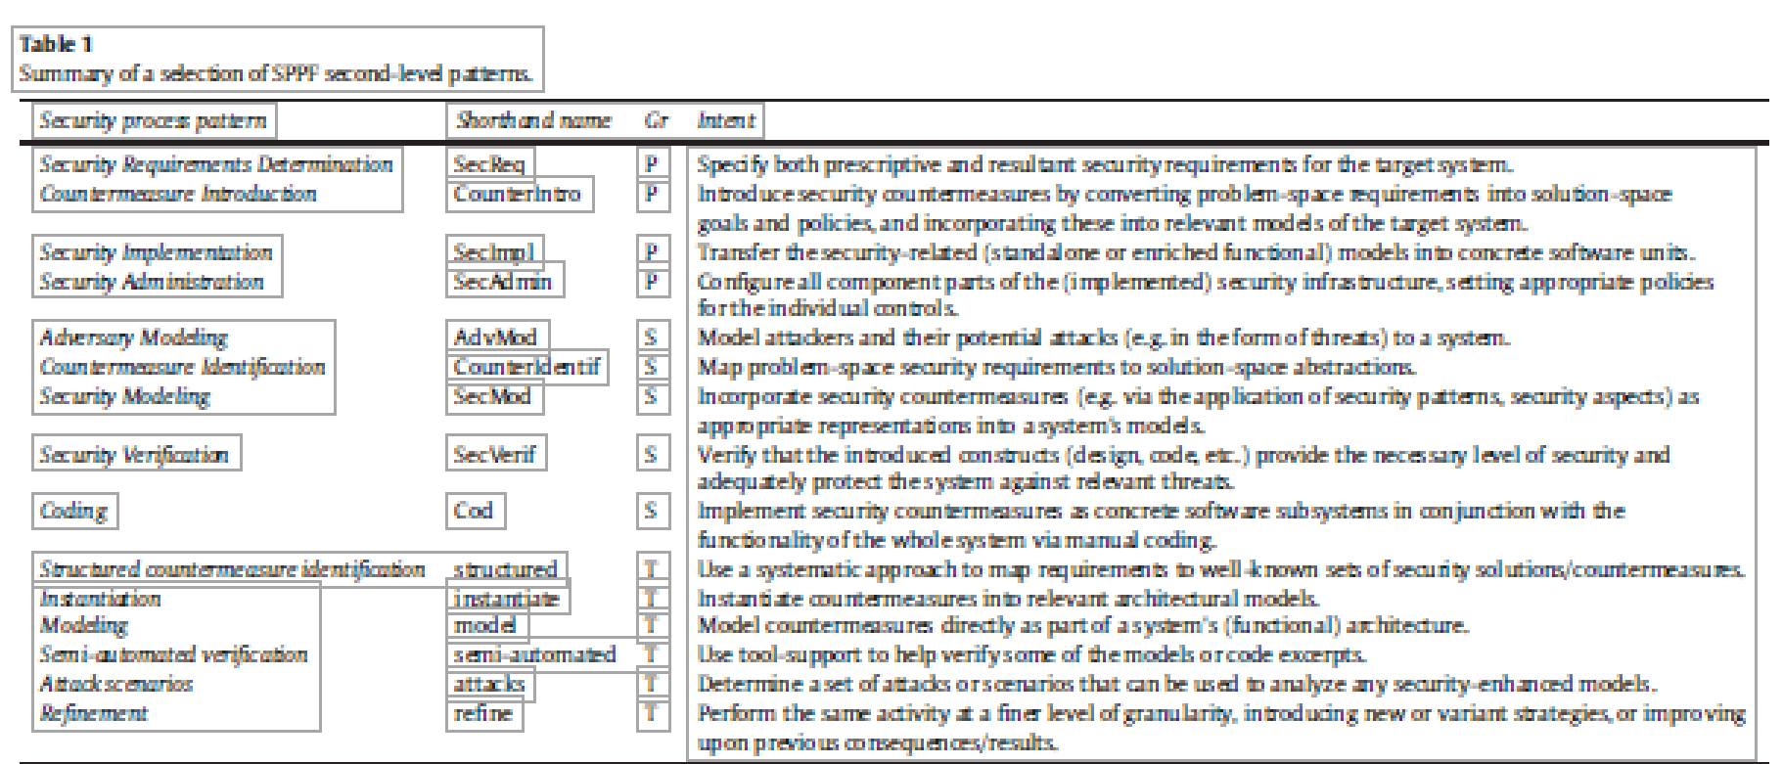

Slide 13
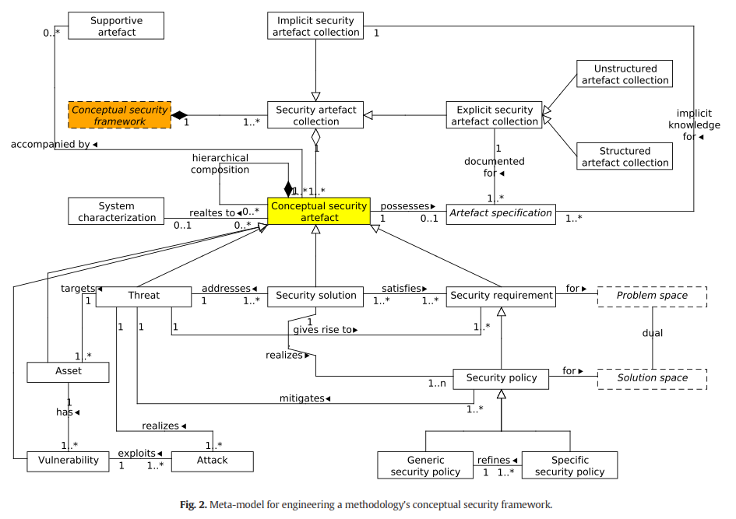

Slide 14

Major elements of CF: Threat taxonomies/libraries
Threat taxonomies/libraries consist of threat patterns, which can be customized and instantiated in different architectural contexts to define specific threats to a system.
Allow developers to quickly and efficiently consider a range of relevant threats during threat modeling.

Slide 15
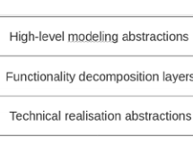
Framework for distributed systems

Slide 17
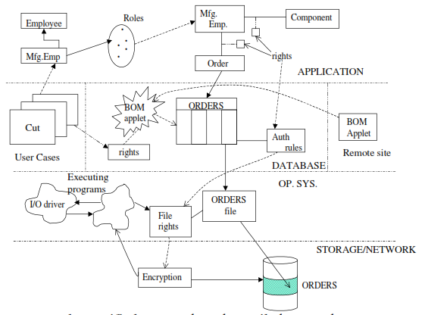
Mappings between architectural levels

Slide 18
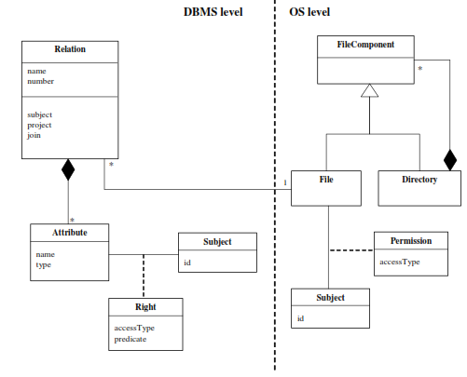
Mapping DBMS to OS

Slide 19
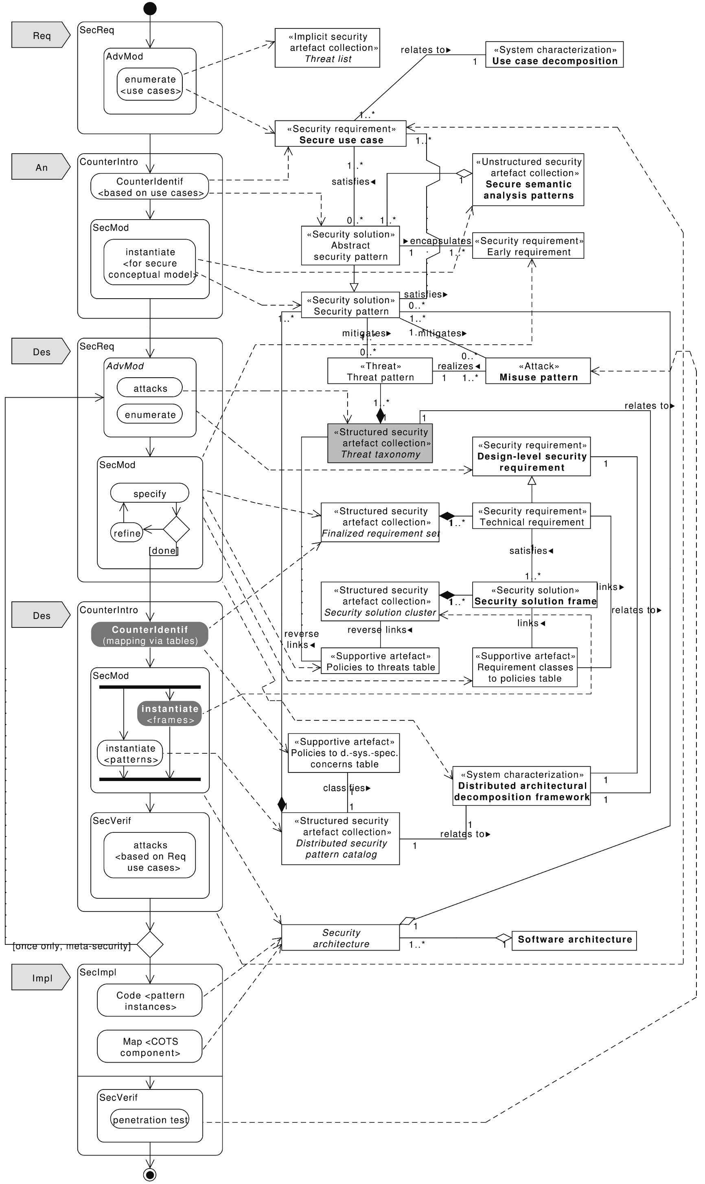

Slide 20
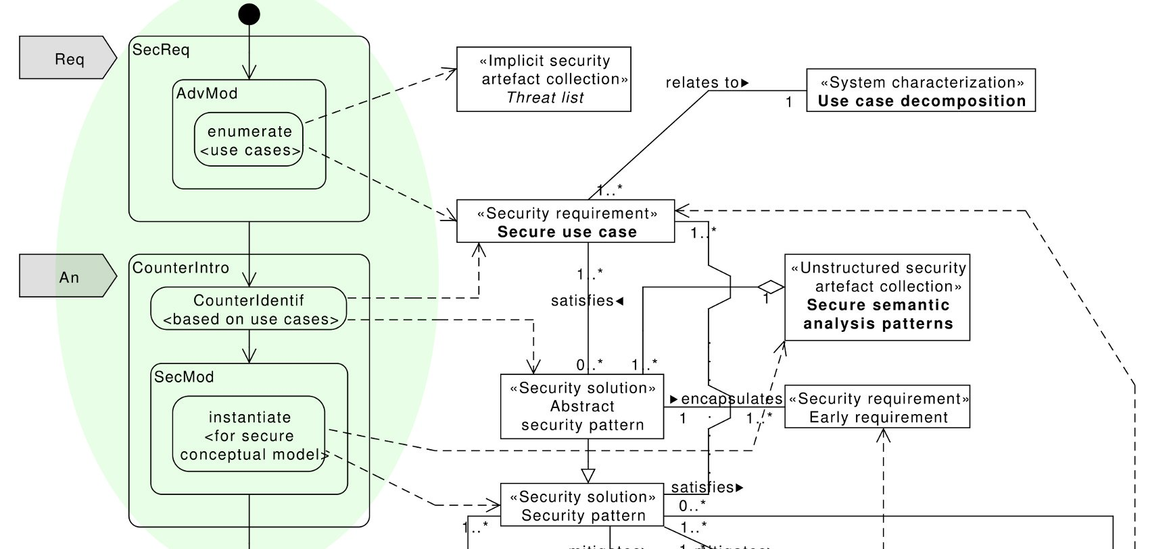
ASE security process overview: Requirements Analysis phase

Slide 21
Analysis stage
Analysis patterns are used to build the conceptual model. Security patterns describe security mechanisms to mitigate threats. We can build a conceptual model where repeated applications of a security model pattern realize the needed defenses and define rights determined from use cases.
We can use Semantic Analysis Patterns (SAPs) to reuse related sets of use cases, e.g., Secure Inventory, Secure Student Registration

Slide 22
Abstract Security Patterns
An ASP is a security pattern that describes a conceptual semantic restriction in a domain which can be a defense to a threat or a way to comply with a regulation, with no implementation aspects.
An ASP describes the essential functions that must be present to handle a threat or regulation in an implementation-independent way.
For example this is the Intent section of an Authenticator pattern: “When a user or system (subject) identifies itself to the system, how do we verify that the subject intending to access the system is who it says it is? Present some information that is recognized by the system as identifying this subject. Once recognized, the subject receives a token as proof.”

Slide 23
Use cases can also be used to find actor rights (authorization rules)
Use cases describe all possible uses of the system
All use cases define all possible and legal accesses
Each actor can be given its needed rights to perform its functions

Slide 25
Role rights for financial institution
Customers can open/close accounts
Customers can initiate trade
Broker can perform trade
Auditor can inspect (read) trade transactions

Slide 26
Conceptual model:
9/26/2018
26

Slide 27
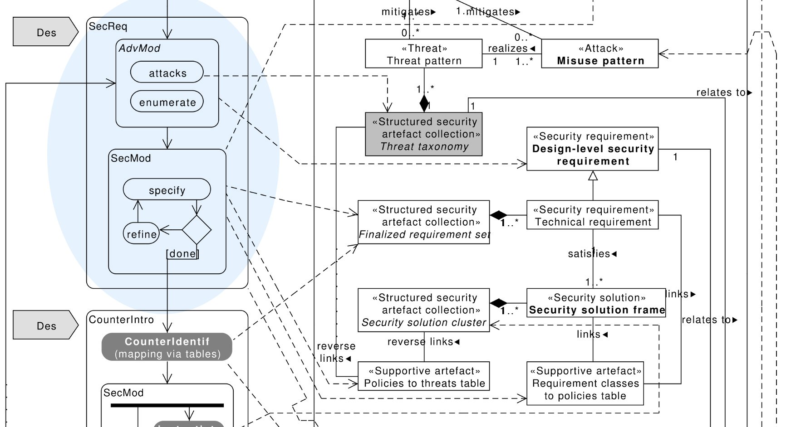
ASE security process overview: Design phase (1/2)

Slide 28
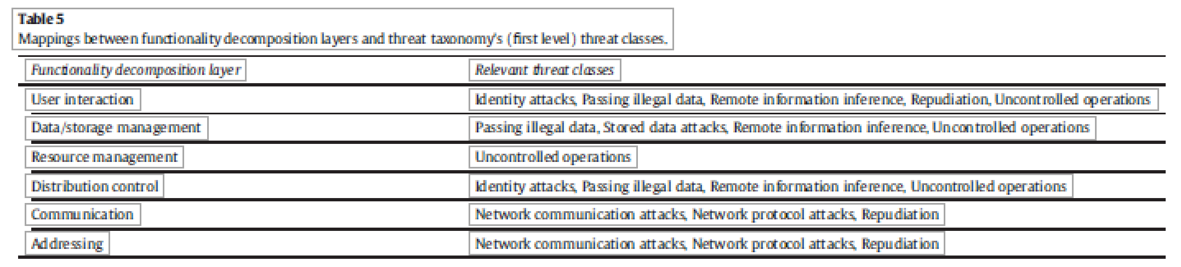

Slide 29
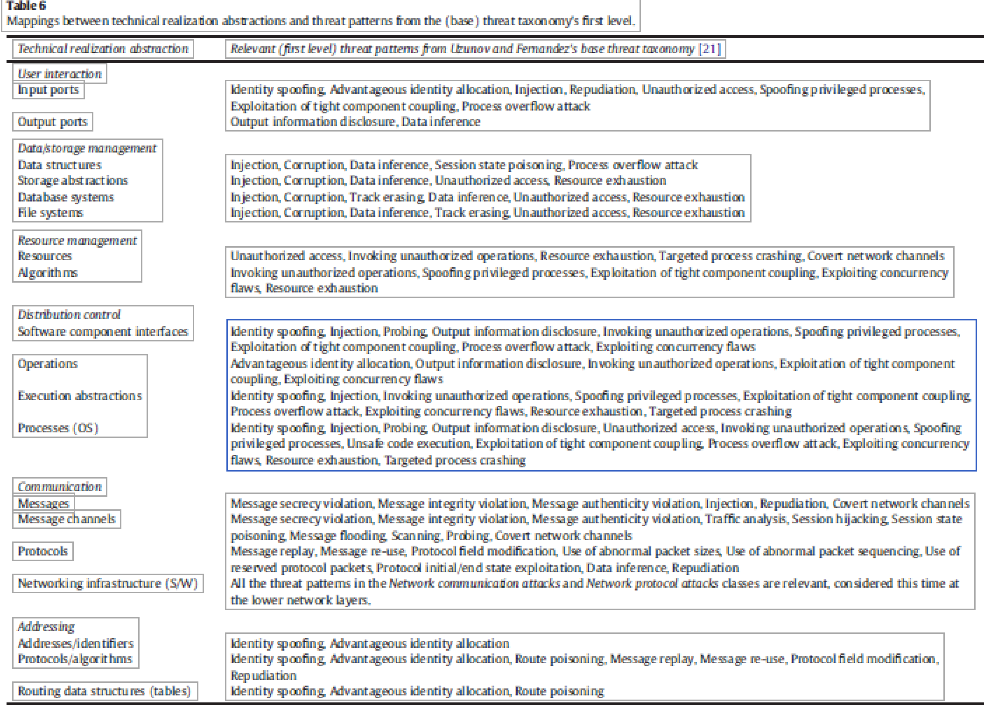

Slide 30
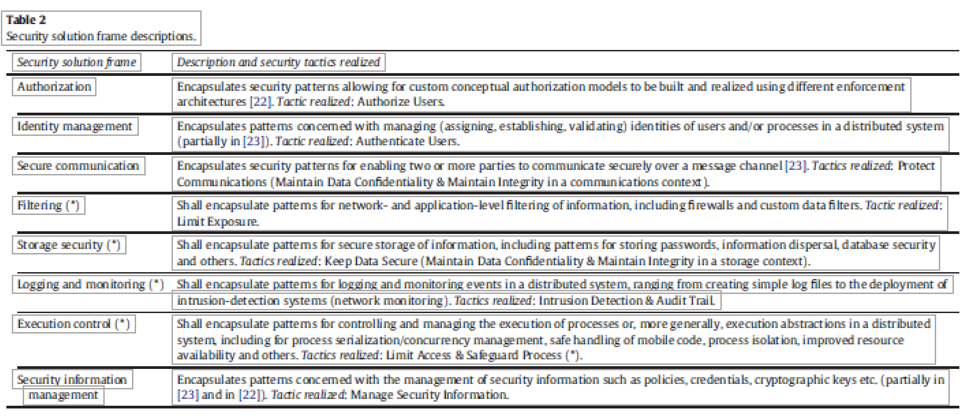

Slide 31
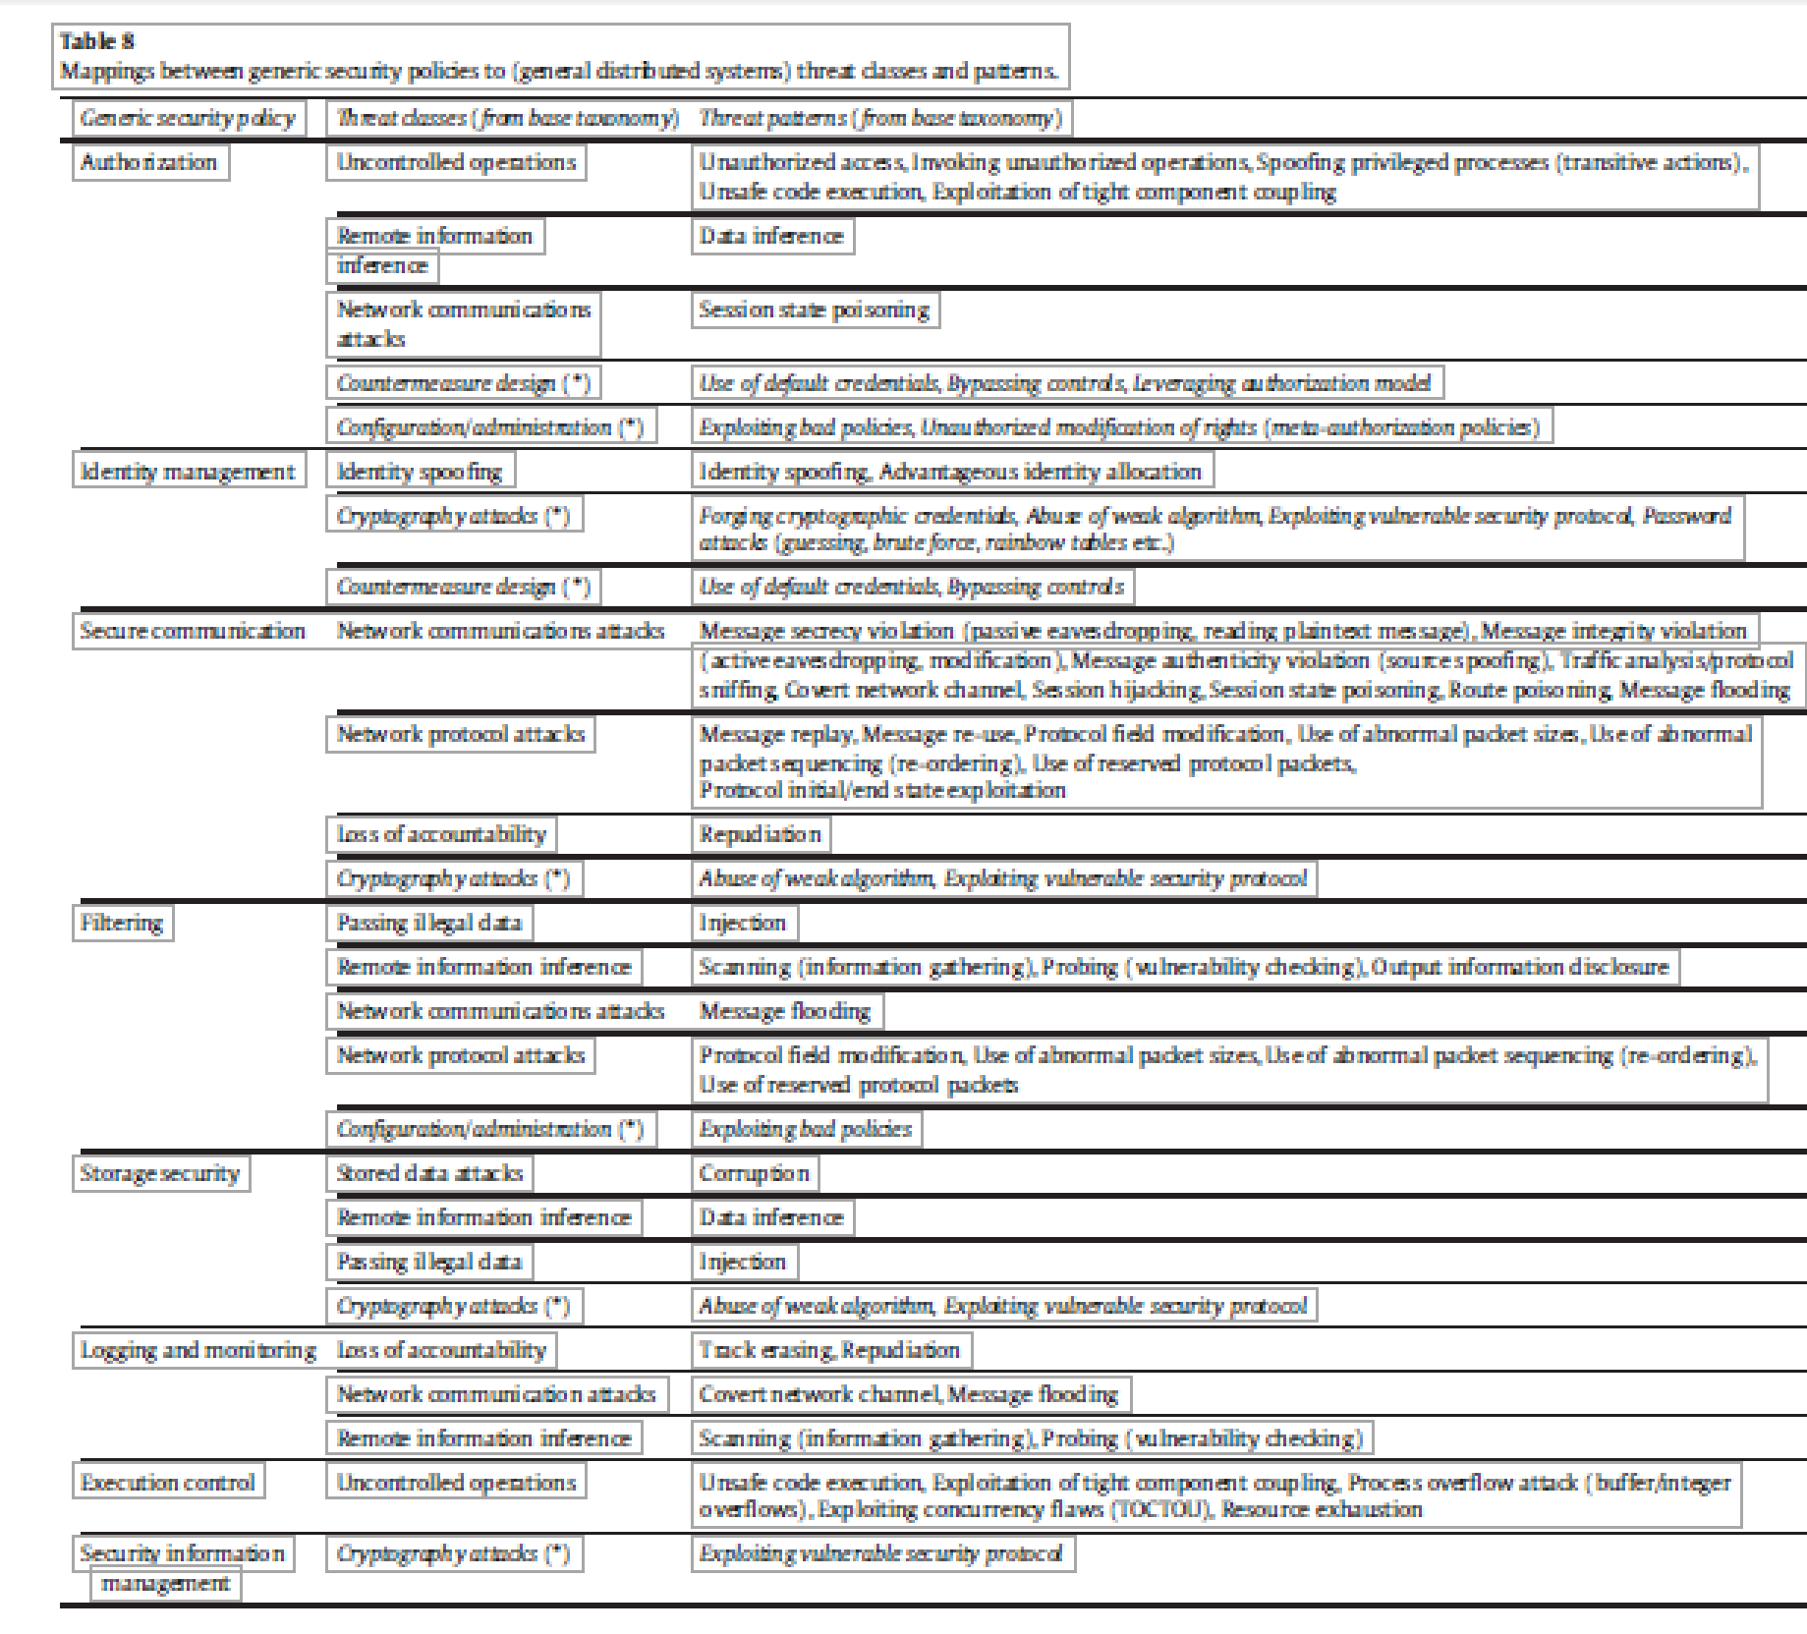

Slide 32
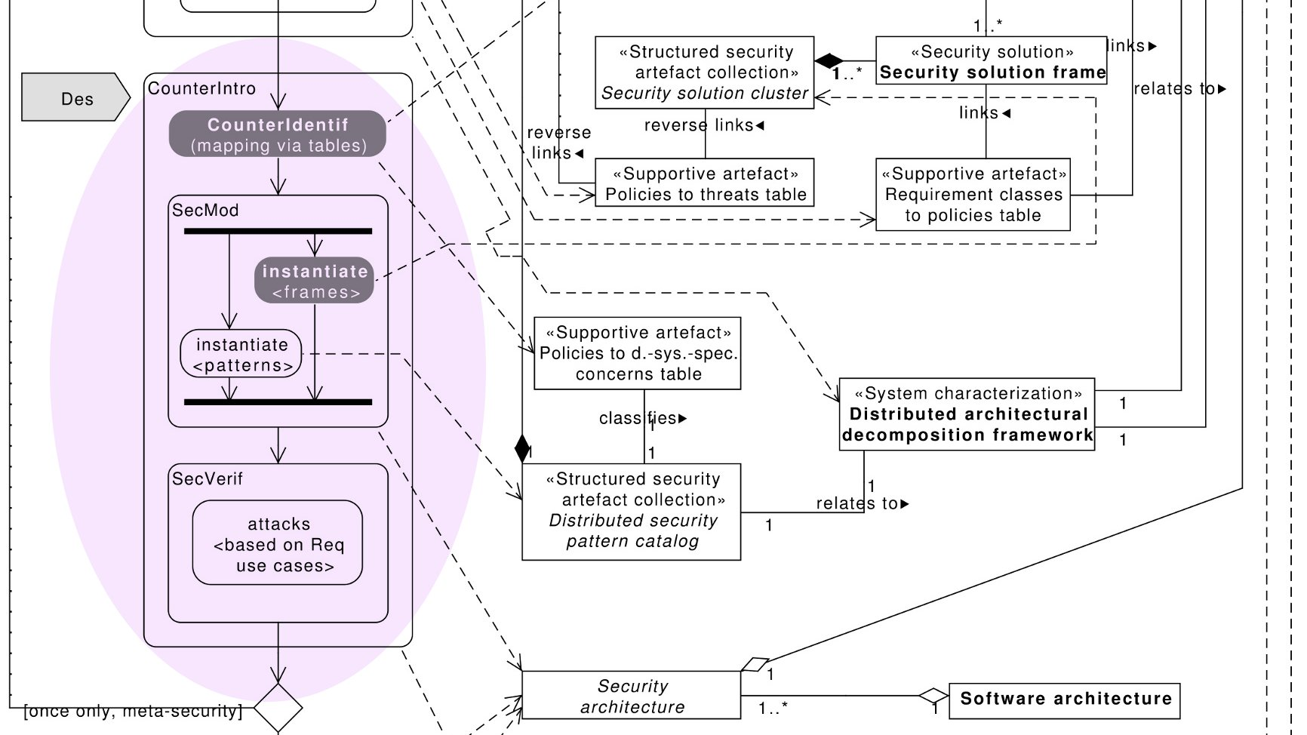
ASE security process overview: Design phase (2/2)

Slide 33
Design stage
When we have the possible attacks to a system, design mechanisms are selected to stop these attacks.
User interfaces should correspond to use cases and may be used to enforce the authorizations defined in the analysis stage. Secure interfaces enforce authorizations when users interact with the system.
Components can be secured by using authorization rules for components.
Distribution provides another dimension where security restrictions can be applied.

Slide 34
Design stage patterns
We can map from the application level to the lower levels
The next diagram shows the application, distribution, database/communication, and operating system/communication levels

Slide 37
Security is applied along the distribution path
Proxies and adapters apply authorization (Customer access to Accounts)
Proxies and adapters apply authentication (Branch office and central office mutual authentication)
Logging can be applied in the Transaction view (not shown)
Broker communications can be encrypted
Messages from Customers for trade can be signed

Slide 38
Middleware patterns

Slide 39
Secure Broker
Secure Broker extends Broker to provide secure interactions between distributed components.
The Broker architectural pattern can be used to structure distributed software systems with decoupled components that interact by remote service invocations. A broker is responsible for coordinating communication, such as forwarding requests, as well as for transmitting results and exceptions [Bus96].
Proxies insulate their callers, Client and Server, from the implementation details of communications. The Bridge class implements a similar concept for communications between Brokers. There are two basic use cases for Broker, illustrating its role in structuring transparent communications between clients and servers: Server Registration and Client Requests Service.

Slide 40
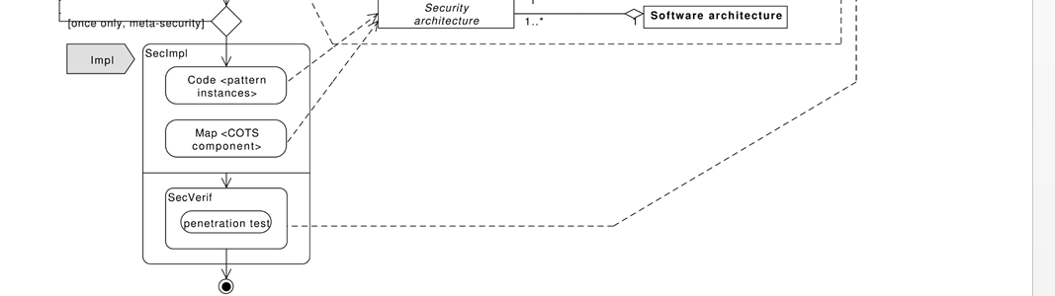
Implementation phase

Slide 42
Implementation stage
Requires reflecting in the code the security rules defined in the design stage.
Because these rules are expressed as classes, associations, and constraints, they can be implemented as classes in object-oriented languages.
In this stage we can also select specific security packages or COTS components, e.g., a firewall product, a cryptographic package
Some of the patterns identified earlier in the cycle can be replaced by COTS components (these can be tested to see if they include a similar pattern).

Slide 43
J2EE, .NET
Web Services
REST Services
code
Functional
Classes
Security/Reliability
COTS components
NFR
Classes

Slide 44
Deployment for financial institution
firewalls
VPN
Customers
authorization
.
Web Server
Web Application
Server
.
Internet
.
certificates
IDS
Databases
message
encryption
certificates
ATMs,
Browsers
authorization
encryption
Brokers
Auditors

Slide 45
A voting system

Slide 46
1..
1..
Application
*
UseCase
*
Activity
Threat
Pattern
encapsulates
*
targets
*
1
Threat
Asset
1
1
*
*
1
*
1
realizes
realizes
1
1
*
1
1
Attack
exploits
Vulnerability
Attack
Pattern
1..
*
*
*
encapsulates
realizes
*
neutralizes
1
Misuse
Pattern
*
SSF
*
*
SC
1
Security
Pattern (SP)
1..
*
SP Family
1..
*
0..1
Compound SP
Simple SP
ASP

Slide 47
Extending the model
Domain
Model
Testing
Conceptual
Model
Testing
Design
Model
Testing
Code
Testing
Domain
Modeling
Regs
Analysis
Design
Coding
Maintenance
Secure
DomainModel
Appi
Use cases
Threat
patterns
Secure
Coding
Data
Collection
.
.
Misuse patterns
.
Security patterns
SRAs
Patching
Appj
Secure Conceptual
Model
Twin Peaks
RA, SRA
Misuse
patterns
Evolution
Monitoring
Security
patterns

Slide 48
Extensions
Domain analysis stage: A domain model (DM) is defined. Legacy systems are identified and their security implications analyzed. Domain and regulatory constraints are identified. Policies must be defined up front, in this phase. A Reference Architecture (RA) is defined from the DM. We can analyze threats and regulations and define Policy-Enhanced models. We relate threats and regulations to use cases. We study each action within a use case and see which threats are possible and which regulations apply. We then determine which policies would stop these attacks or enforce the regulations. From the use cases we can also determine the needed rights for each actor and thus apply a need-to-know policy.
Requirements stage: Each application uses a subset of the use cases of some DMs and includes some new use cases. We repeat the threat/regulation analysis for the new use cases. We eliminate threats based on risk analysis.

Slide 49
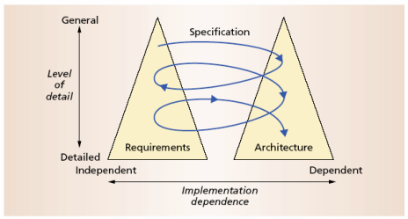
The Twin Peaks Model
Bashar Nuseibeh

Slide 50
Twin peaks
To define each refinement of the architecture we can use RAs which in each stage become more concrete. These concrete architectures introduce architectural artifacts that can also be attacked and therefore must be protected. We refine the goal-based threats to produce a design model which is effectively a SRA. This is refined to produce a new architecture and the cycle repeats.
In each iteration the misuse patterns that describe attacks indicate the architectural units that are used to perform the attack; these units are the places where we can collect evidence of attacks and where we can assess the damage that was done by the attack. Models of this type can be used for automatic generation of attacks to see if evidence can be collected from them using some specific method; dealing with known threats also helps reduce data collection for forensics.

Slide 51
Twin peaks iterations

Slide 52
Reference Architectures
A reference architecture (RA) or domain-specific architecture is a standardized, generic architecture, valid for a particular domain.
It is reusable, extendable, and configurable, that is, it is a kind of pattern for whole architectures and it can be instantiated into a specific software architecture by adding implementation-oriented aspects
From RAs we can derive concrete architectures with different degrees of specificity, e.g. a cloud computing architecture using Oracle products

Slide 53
Security Reference Architecture
The identified threats in the RA can be neutralized by applying appropriate security patterns.
Each threat can be controlled by a corresponding security pattern. Once security patterns are identified, we apply them into the reference architecture in order to stop or mitigate the threats
Security mechanisms are added to the basic RA, including Authenticator, Authorizer, Security Logger/Auditor and others that mitigate specific threats

Slide 54
Monitoring
Monitoring is necessary to enforce SLAs (Service Level Agreements)
The SRA can be used to indicate where we need to monitor and what attacks to expect
There is little work on this subject

Slide 55
Other secure methodologies [Uzu13]
UMLsec
SecureUML
Secure Tropos
Georg/France. –Uses aspects as artifacts.

Slide 56
UMLsec
UMLsec is an extension of the UML [Jur05], defining stereotypes, tags and constraints for expressing a number of security requirements, such as data secrecy and integrity, message secrecy and integrity, information flow restrictions, role-based access control and others.
Each stereotype is applicable to different UML diagrams, including deployment (accounting for communications between nodes), class (accounting for static data and relationships between elements), activity (accounting for intra-object properties) and sequence diagrams (accounting for interactions and protocols).
By annotating UML models with the UMLsec security extensions, developers embody a system's security requirements at the design level.

Slide 57
UMLsec II
While useful in itself, simply annotating models with security requirements does not guarantee that the models will conform to their corresponding requirements.
UMLsec's real value lies in the use of advanced tool-support for precisely this kind of security verification. The UMLsec tool-suite [Jür05, Jür08] consists of a number of analysis tools and plugins for verifying static and dynamic models as well as checking access control permissions.
To support formal verification, the subset of UML employed by UMLsec is given a formal (behavioural) semantics via UML machines, allowing for the execution semantics of UMLsec models to be converted to first-order logic and checked via automated theorem provers against the relevant security requirements. If conformance fails, an attack sequence violating the security requirements is automatically generated and provided to developers for analysis [Bes07].

Slide 58
UMLsec III
For the purposes of verification, UMLsec allows the capabilities of adversaries to be specified via an adversary type, which formally models the threats related to the deployment view of a system, namely, those related to communication (delete, read, insert) and individual nodes (access).
Two standard adversary types are defined in UMLsec that can be annotated on UML package diagrams: a default attacker, representing “an outsider adversary with modest capability [Jür05], and an insider, representing an attacker with internal access to a system.
It is not appropriate for using security patterns since they cannot be represented by a fixed, formally specifiable architecture.

Slide 59
MDS and Secure UML [Bas09, Bas11]
Model-Driven Security is based on a linguistic approach to modeling security, which proposes the creation of custom language schemas combining security modeling languages with functional (system or domain) modeling languages, enabling developers to model the security and functional aspects of a system simultaneously.
To bridge the gap between the system and security modeling languages in each schema, a third, intermediate language – a “dialect” – is required, which tailors the security language in reference to a particular (system) language with more concrete or refined semantics and helps to merge the corresponding language metamodels (abstract syntax) and vocabulary.
A dialect for a security language allowing the specification of access control policies such as SecureUML, for example, can specify which model elements of a system language can be valid protected objects and what actions can be performed on them. This general composition of languages results in families of secure design modeling languages that provide the security properties specifiable by each security language as system modeling constructs in a coherent fashion, with the concrete syntax (notation) used for functional models.

Slide 60
MDS II
As long as a new security modeling language is not required (i.e. if the existing SecureUML language schemas are sufficient for the task at hand), the ease of use of Model-Driven Security is relatively high, especially given the popularity of UML.
However, since no guidance is provided as to where and why security specifications are introduced into design models, the methodology requires a security expert. In this sense, Model-Driven Security is akin to UMLsec in helping experts to perform their tasks better

Slide 61
Secure Tropos
Secure Tropos [Mou11 ]is an extension of the Tropos agent-oriented development methodology with the addition of UMLsec for detailed design.
Tropos considers five development stages: early requirements, late requirements, architecture development, detailed design and implementation. During early and late requirements, a set of models are developed that capture security requirements using modeling notions such as actors, security goals, tasks and actor dependencies.
Secure Tropos employs security patterns during the architecture development stage with the aim of helping to map the conceptual models created earlier to known, predictable sets of design elements and thereby reduce the risks associated with ad-hoc realizations of the security requirements
The patterns used are agent-specific and address only a limited range of security concerns. The requirements for agent-specific patterns implies that standard collections of security patterns (e.g. Schumacher et al., 2006) are not applicable and thus cannot be used.

Slide 62
Georg/France [Geo09]
Security solutions are expressed as aspects, which are treated as patterns.
Their work is an attempt to make rigorous specifications of design patterns in UML by the use of role models (approximately meta-model level templates) and accompanying OCL constraint templates, which restrict the scope of possible pattern realizations in terms of model elements.
Such rigorous specifications are useful because they determine the degree to which the design patterns (i.e. their models) can be varied.
France et al.'s specifications are unable to capture the complete semantics of corresponding solutions, and, unlike security patterns, do not aspire to provide guidance or models of tried-and-tested solutions.

Slide 63
Aspect-Oriented Programming (AOP)
Initial work analyzed existing programs and removed concerns such as security or optimization and put them into separate modules
Later the idea was extended to include semantic aspects of the program, or ‘themes’. Themes include concerns such as customer or account information. These ideas were also applied to the construction of new programs.
Separation of concerns refers to the ability to identify, encapsulate, and manipulate those parts of software that are relevant to a particular concern (concept, goal, purpose, etc.). Concerns are the primary motivation for organizing and decomposing software into manageable and understandable parts.

Slide 64
References
[Uzu13] Anton V. Uzunov, E.B.Fernandez, and K. Falkner, “Engineering Security into Distributed Systems: A Survey of Methodologies”, Journal of Universal Computer Science, Vol. 18, No. 20, 2013, pp. 2920-3006. http://www.jucs.org/jucs_18_20/engineering_security_into_distributed
[Uzu15]Anton Uzunov, E. B Fernandez, Katrina Falkner, “ASE: A Comprehensive Pattern-Driven Security Methodology for Distributed Systems”, Journal of Computer Standards & Interfaces , Volume 41, September 2015, Pages 112-137, http://www.sciencedirect.com/science/article/pii/S0920548915000276
Anton Uzunov, E. B Fernandez, Katrina Falkner, “Security solution frames and security patterns for authorization in distributed, collaborative systems”, Computers & Security, 55, 2015, pp. 193-234, doi: 10.1016/j.cose.2015.08.003
A.Uzunov and E.B.Fernandez, “An Extensible Pattern-based Library and Taxonomy of Security Threats for Distributed Systems”- Special Issue on Security in Information Systems of the Journal of Computer Standards & Interfaces. 2013. http://dx.doi.org/10.1016/j.csi.2013.12.008
[Fer13] E.B.Fernandez, “Security patterns in practice: Building secure architectures using software patterns”, Wiley Series on Software Design Patterns, 2013.
E. B.Fernandez, Nobukazu Yoshioka, Hironori Washizaki, and Joseph Yoder, "Abstract security patterns for requirements specification and analysis of secure systems'', Procs. of the WER 2014 conference, a track of the 17th Ibero-American Conf. on Soft. Eng.(CIbSE 2014), Pucon, Chile, April 2014

Slide 65
Refs II: UMLsec
J. Jürjens, Secure Systems Development with UML, Springer, 2005.
J. Jürjens, Model-based security testing using UMLsec: a case study, Electron. Notes Theor. Comput. Sci. 220 (1) (2008) 93–104 (Procs. MBT 2008).
B. Best, J. Jürjens, B. Nuseibeh, Model-based security engineering of distributed information systems using UMLsec, Procs. 29th International Conference on Software Engineering (ICSE), IEEE, 2007, pp. 581–590.

Slide 66
Refs. Tropos and others
[Bas09] Basin, D., Clavel, M., Doser, J. & Egea, M.: “Automated analysis of security-design models”; Inf. Softw. Technol. 51(5), (2009), 815-831.
[Bas11] Basin, D., Clavel, M., Egea, M.: “A decade of model-driven security”; In Procs. of the 16th ACM Symposium on Access Control Models and Technologies (SACMAT). Innsbruck, Austria, ACM, (2011), 1–10.
[Geo09] Georg, G., Ray, I., Anastasakis, K., Bordbar, B., Toahchoodee, M., Houmb, S.H.: “An aspect-oriented methodology for designing secure applications”; Inf. Softw. Technol. 51(5), (2009), 846-864.
[Mou11] Mouratidis H. Secure Software Systems Engineering: The Secure Tropos Approach (Invited Paper). J. Softw. 2011;6(3):331-9.

